Slide 1
Caught on Cam: Bus Lane Data
Business questions
How can repeat violators be reduced?

Slide 2
General prompts to consider
01
What MTA bus routes most utilized by CUNY Hunter Students?
02
ACE’s effect on bus speed(between 2023-2025)
03
Hypothetical solutions:

Slide 3
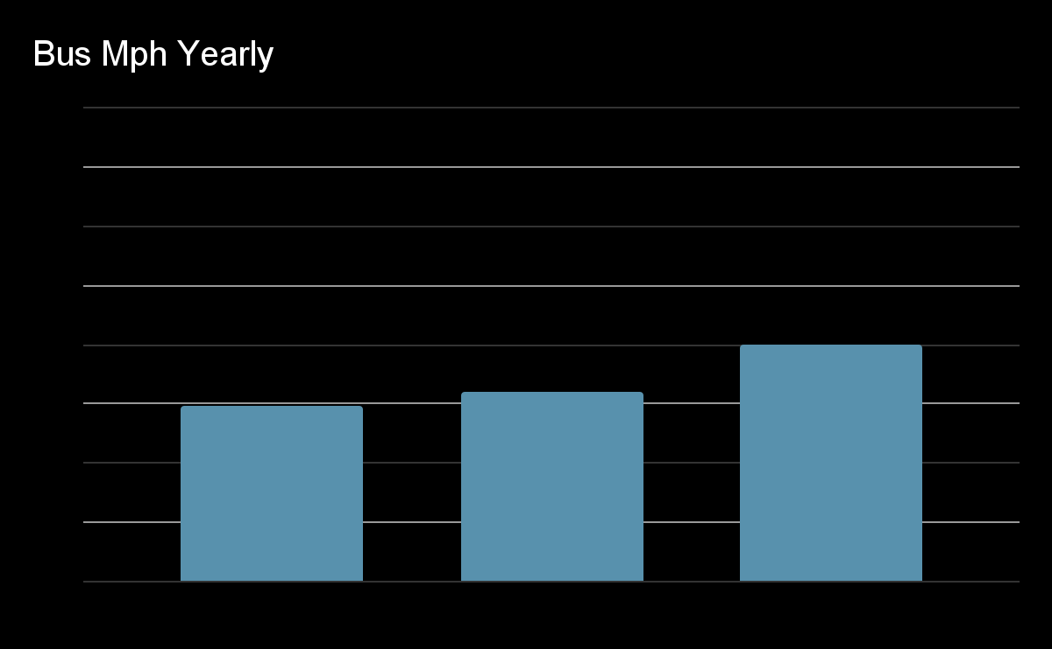
MTA bus routes most utilized by CUNY Hunter Students?
Approximate Speed
(And the change of bus speeds over time through regulation by ACE)
We infer that the most utilized bus routes used by Hunter College Students would be the ones near the campus. Which would be the M101, M102, M103, M66, M98. Of these 5, only the M101 route has implemented the ACE program on 09/16/2024.
Years / Dates
A 0.42% increase compared to 1.79% increase.
When ACE was enforced
2025 Bus Speeds
2023-2024 Bus Speeds

Slide 4
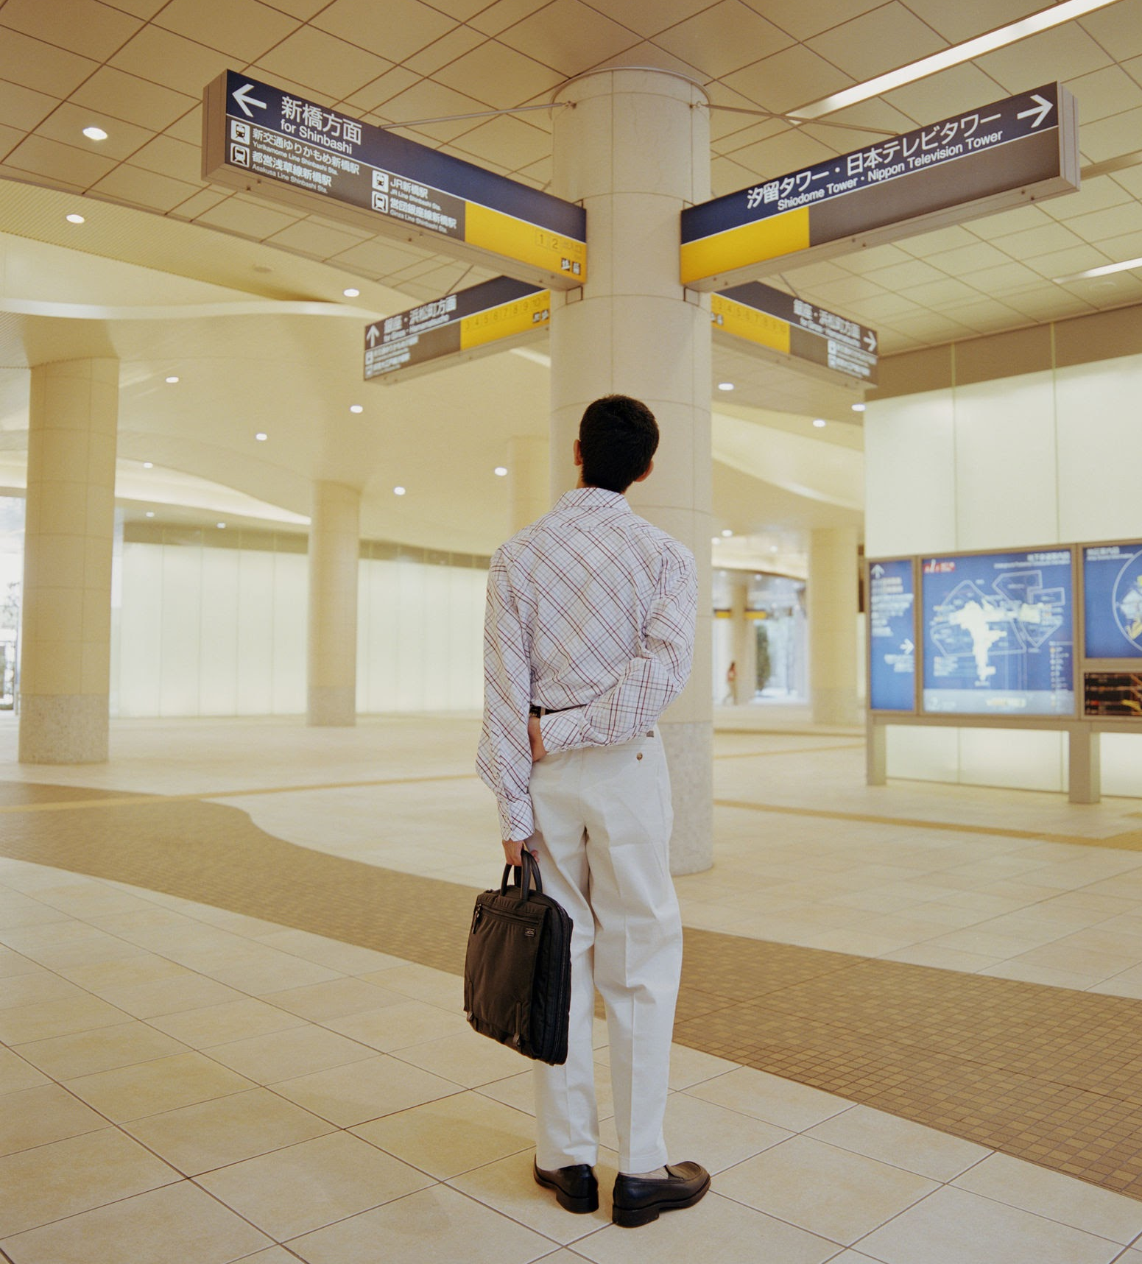
Comparing ACE’s speed improvement
When analyzing the average bus speed of the M101 per year, from 2023 to 2025, there has been an increased improvement in road speeds. The increase of bus speeds from 2023 to 2024 (before ACE implementation) was less than the increase from 2024 to 2025 (during and after ACE)

Slide 5
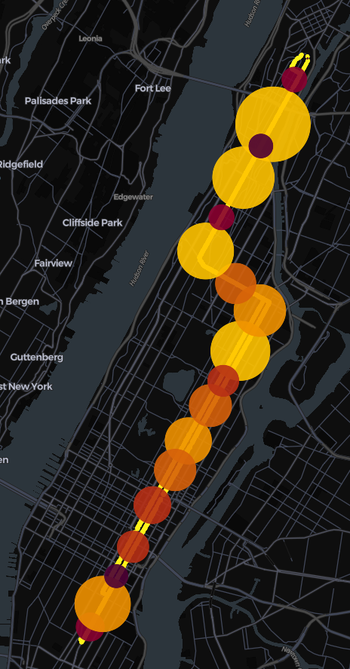
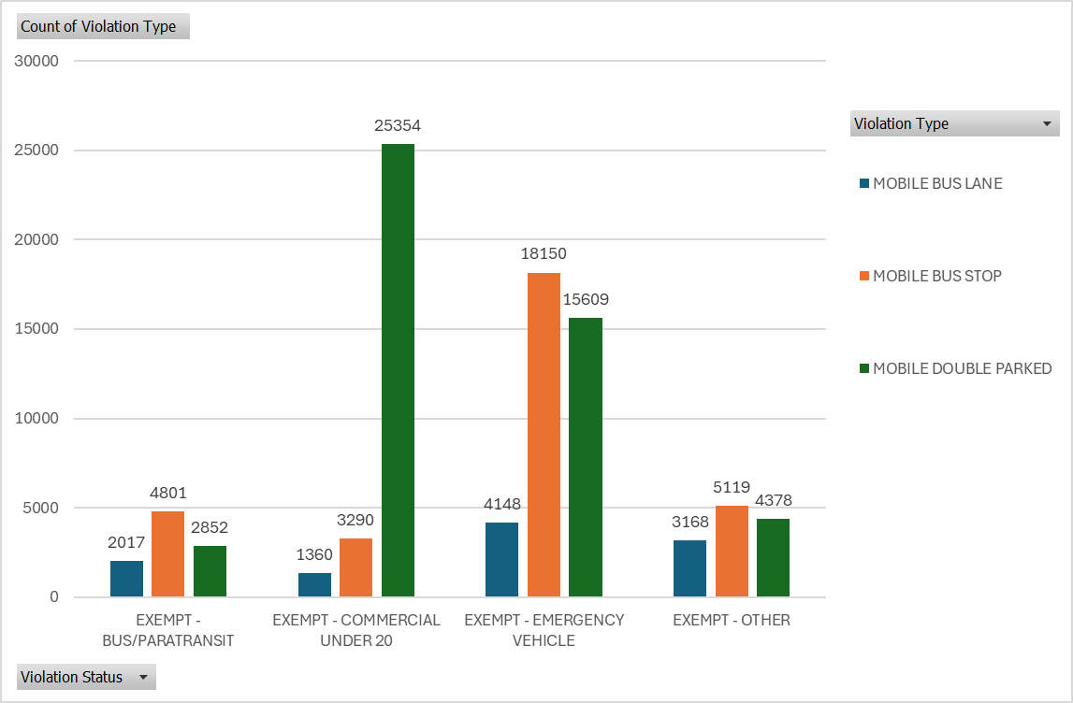
Exempt vehicles along the M101 Route
Most of the violations are on along intersections and stops. The vehicles exempt do have repeat offenders. The most of which are Emergency Service Vehicles.
ACE violations on M101
Notes:
ACE violations on M101

Slide 6


So why does this matter? What are some Hypothetical Solution.
The top 5 vehicles with repeated violations were all Emergency Vehicles, mostly located in busy intersections. Maybe we can add a lane reserved for emergency vehicles.
ACE’s has increased the average bus speeds to 7.5 from 7.25 which adds up to 6.533%.

Slide 7
Summary/Closing thoughts
Most students would enter college through 5 bus routes: M101, M102, M103, M66, M98
Out of those buses the M101 was ACE enforced.
Generally speaking Ace buses have an increased speed of 7.25 to 7.5.
Exceptions:
The majority of delays in these buses are due to emergency vehicles, paratransit, Drivers, Commercial vehicles.
The majority of these violations are due to emergency vehicles.
Solutions:
To fix the excess of violation caused by emergency vehicles, we can offer emergency vehicles routes.
Notes:
New York City's congestion pricing officially went into effect on January 5, 2025

